Slide 1
Operating System

Slide 2
Agenda
Operating System - Overview
Memory Management
Process Management
File Management
Device Management

Slide 3
Objectives
At the end of this module, you will be able to:
Define Operating System and different types of Operating System and list the functions
Define Memory Management Unit and explain the use of paging and segmentation in memory management
Describe process management and process lifecycle using state diagram
Describe various responsibilities of file management system and compare different file systems
Describe allocation policy in device management

Slide 4
Delivery Plan
Topic | Objectives | Duration (in minutes)
Introduction | Define Operating System and different types of Operating System and list the functions | 30
Memory Management | Define MMU and explain the use of paging and segmentation in memory management | 45
Process Management | Describe process management and process lifecycle using state diagram | 45
File management | Describe various responsibilities of file management system and compare different file systems | 45
Device Management | Describe allocation policy in device management | 30

Slide 5
Operating System - Overview

Slide 6


Operating System
It is a set of programs which act as an intermediary between the user and the computer hardware
  Execute user programs and make solving user problems easier.
  Use the computer hardware in an efficient manner
  Provides an to execute different types of applications
It is viewed as a Resource Allocator or Resource Manager
  Memory
  Processor
  Peripherals
  Information
Operating
System
Notes:
The primary goal of Operating System is to provide the execution environment for the system programs and application programs.
Secondary Goal of Operating System is to manage and efficiently allocate the system resources to various applications which must be executed.
Examples:
WINDOWS XP
WINDOWS NT
WINDOWS VISTA
UNIX
LINUX

Slide 7
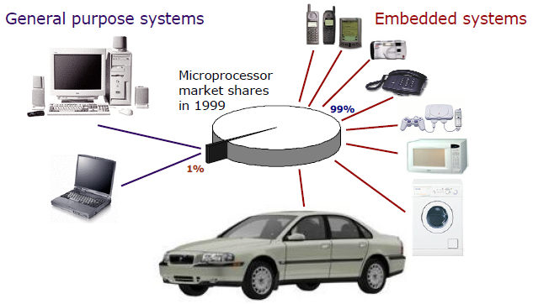
Operating System – Bird’s eye view
General purpose operating systems
  Windows 95/98/2000/NT/XP
  Linux
  Sun Solaris
  HP-UX
  MacOS
Application specific operating systems, e.g. real-time
  OSE-Delta
  VxWorks
  Chorus
  RT-Linux, RED-Linux
  EPOC, RT-Mac
  etc.

Slide 8
Operating System - Types
Real-Time Operating System (RTOS)
  Used in computers that control machinery, robots, scientific instruments and industrial systems
  Examples: Real-Time Linux, Real-Time Windows NT
Single-user, Single task
  In this type of OS, one user can efficiently perform one task at a time
  Examples: The Palm OS used in Palm handheld computers
Single-user, Multi-tasking
  In this type of OS, single user has several programs in execution at the same time
  Examples: Windows, Mac OS, Linux
Multi-user
  In this type of OS, many different users simultaneously utilize the resources of the computer
  Examples: Unix, Linux and mainframe operating systems, such as MVS

Slide 9
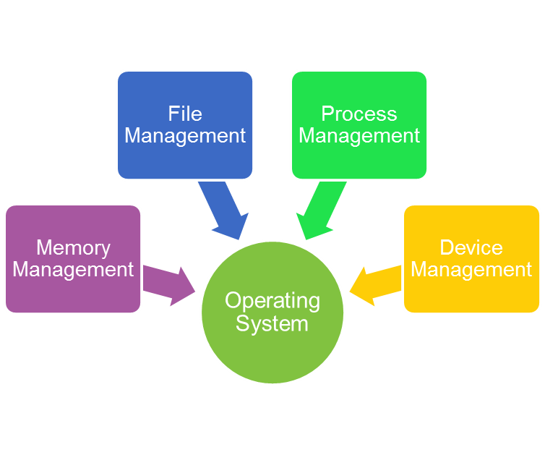
Operating System – Functions
As a User/ Computer Interface
As a Resource allocator
As a Control program
As a Kernel
Major Functions of OS
Notes:
As a User/Computer Interface
Program creation & execution
Access to I/O devices
Controlled access to files
System access, Error detection and responses
As a Resource allocator (manages and allocates resources)
Processing Elements, CPUs
Memory, Devices and Data resources
Control program
controls the execution of user programs and operations of I/O devices
Kernel
the one program running at all times (all else being application programs, which includes system utilities).

Slide 10
Layers of Computer System
User 1
User 2
User 3
….
User n
Interpreter
System Programs & Application Programs
Notepad
Compiler
…
Database Application
…
Operating System
Computer Hardware
Notes:
Operating System provides environment to execute different types of applications e.g. application programs , system programs or database applications etc.

Slide 11
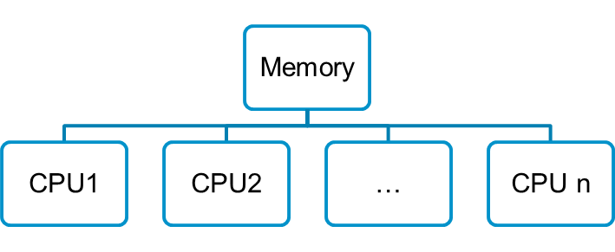
OS Programming - Classification
  Uni-programming
    A single job is stored in the memory at any point of time
Multiprogramming
  multiple jobs are stored in main memory; Multiple users can have access to the system concurrently
Multiprocessing
  More than one processor in a system and execute jobs concurrently
Os
Job1
Unused/Waste
OS
Job1
Job2
Other jobs
can be stored
Notes:
In Uni-programming also known as sequential program execution, only one program(job) can reside in main memory at any point of time.
CPU executes this program. When program is performing some I/O operation, CPU sits idle for that time. Thus, precious CPU time is wasted in waiting.
In multiprogramming, when one job is performing some I/O operation, CPU can start executing other job that is ready in the memory.
In multiprocessing, there are multiple processors. Every processor is capable to execute a different job or thread.
Note on terminology:
Multitasking/multiprogramming refer to the number of programs running
Multiprocessing refers to the number of CPUs in the system

Slide 12
Quiz
State True or False:
Operating System is an application software
Memory space allocation is one of the responsibilities of Operating System
CPU utilization will be high in uni-programming
Memory utilization will be high in Multiprogramming
Every processor executes the same job in Multiprocessing

Slide 13
Memory Management

Slide 14
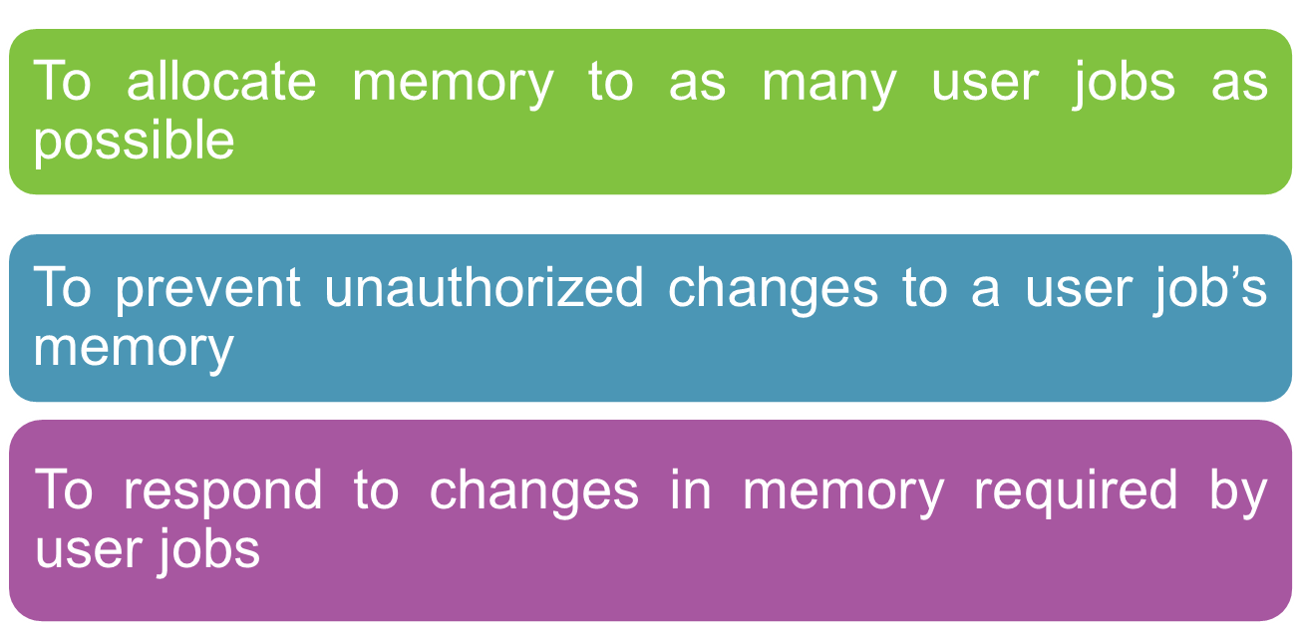
Memory Management
Goals of Memory Management
Notes:
Several processes must be kept in memory at the same time to improve the CPU utilization and the speed of the response of the computer to its users. Memory management manages memory for various user jobs.

Slide 15
Memory Management - How?
Logical versus Physical Address
Logical address
– address generated by CPU, also known as virtual address
Physical address
– address seen by the memory unit
Logical and physical addresses are the same in compile-time and load-time address-binding schemes, logical (virtual) and physical addresses differ in run-time address-binding scheme

Slide 16
Memory Management Unit (MMU)
MMU is a hardware component
Responsible for managing accesses to memory as requested by the CPU
Translates logical address to physical address
Memory protection and cache control are its other functions
Logical
Address
Physical
Address
CPU
MMU
MEMORY

Slide 17
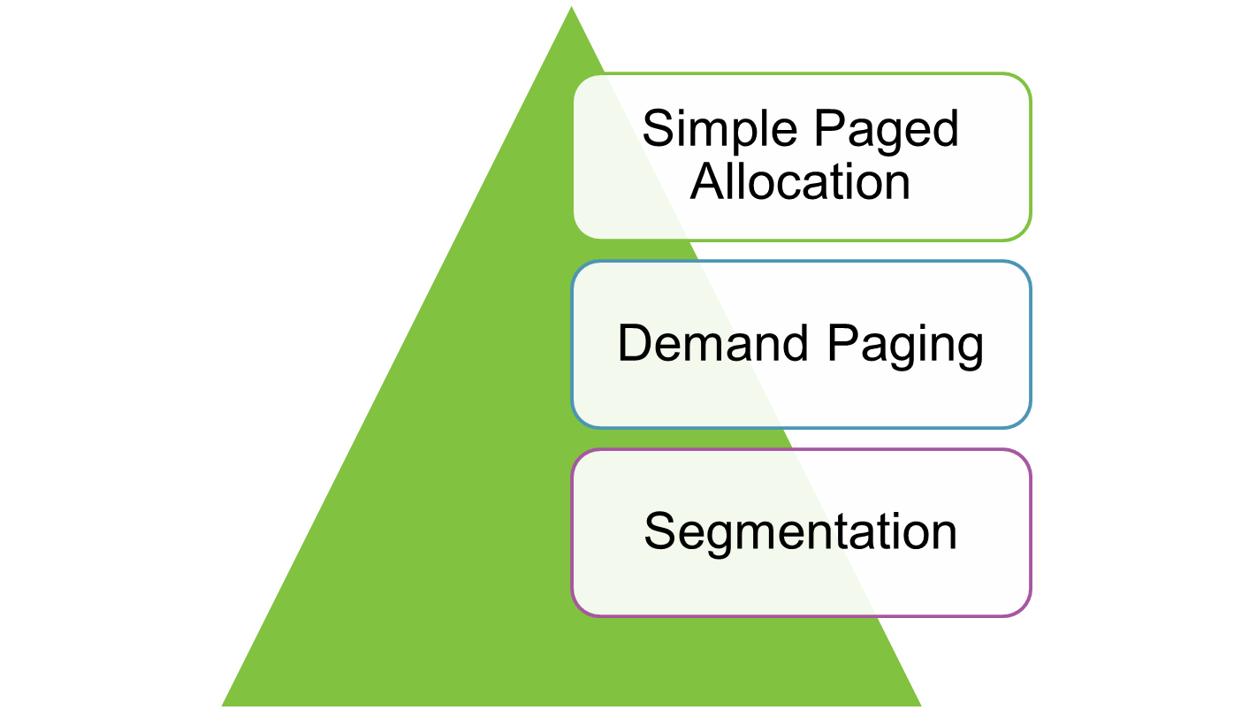
Memory Management Schemes

Slide 18
Simple Paged Allocation
Divides the address space of job into pages of the same size
Divides the main memory address space into blocks/ frames
Pages are units of memory that are swapped in and out of primary memory
All pages for a job should reside in memory
Pages are grouped together for a given user job and are placed in page tables
Free Frame
Free Frame
Frame 0
Frame 1
Page 0
Page 1
Page 2
Page 3
Frame 2
Page 0
Page 1
Frame 3
Job 2
Job 1
Frame 4
Frame 5
Frame 6
Frame 7
Memory Space
Notes:
Advantage:
As each page is separately allocated, the user job need not be contiguous.
Disadvantages:
Extra memory required for storing page tables
Considerable amount of hardware support is required for address transformations etc.
All the pages of a job must be present in memory

Slide 19
Demand Paging
Illusion of infinite memory available for the user jobs (Virtual Memory)
A page is loaded into the main memory only when there is a demand from the hard disk
Frame 0
Page 0
Page 1
Frame 1
Job 1
Page 0
Page 1
Page 2
Frame 2
Frame 3
Job 2
Memory

Slide 20
Segmentation
Segment is a group of information
Segment is a logical entity
A job is divided into segments of variable length
  E.q. a program can consist of main function and one or more user defined functions referred by different names and are of varying length. One segment can correspond to main function or a user defined function.
Segmentation supports the user view of memory
s
d
1 | 42
42
Length
(Bytes)
Byte Address
0
1
2
1024 | 14240
4096 | 2048
6144 | 20420
2048
2048
+
2090
…
Segment Table
Memory

Slide 21
Quiz
MMU is a part of OS (True/ False)
Segmentation supports physical view of memory (True/ False)
In simple paged allocation, all the pages of a job must be present in memory in contiguous memory locations (True/ False)
Segment is a physical entity (True/ False)

Slide 22
Process Management

Slide 23
Process Management
Processor
  Processor is a hardware component that executes instructions
Process
  Program in execution is known as a process
  Process is an active entity whereas a program stored on disk is a passive entity
  Process requires processor, memory and I/O resources for its execution
Notes:
The computer system today allows multiple programs to be loaded into memory and to be executed simultaneously but only one instruction is executed at any point of time.

Slide 24
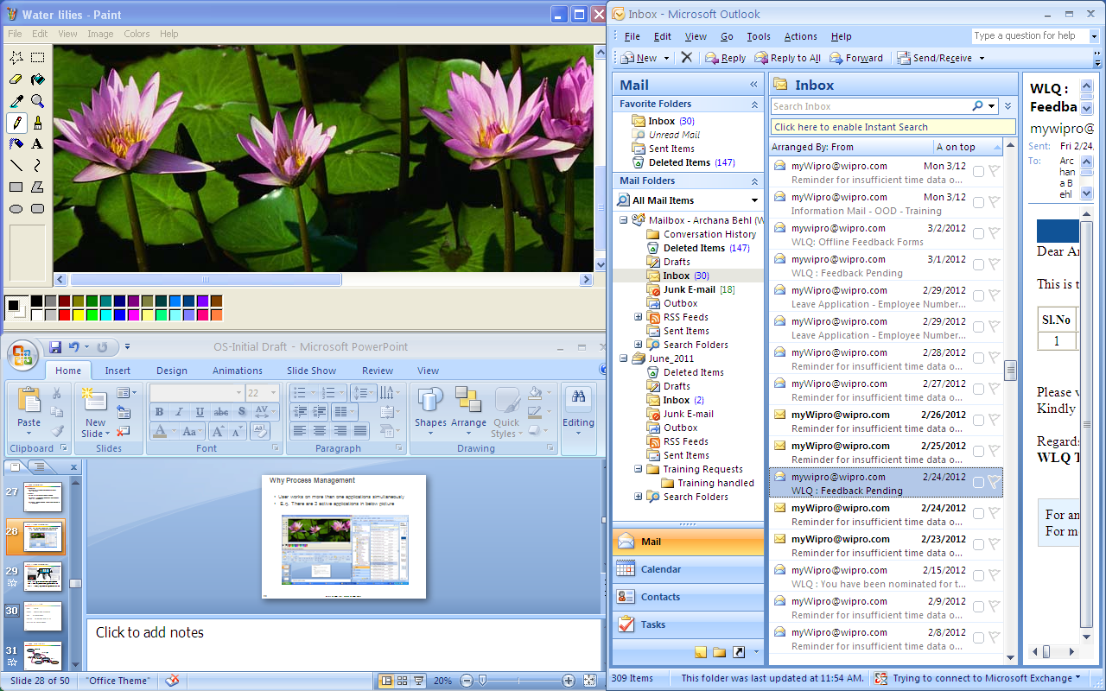
Why Process Management
User works on more than one applications simultaneously
E.q. There are 3 active applications in below picture

Slide 25
Why Process Management (Contd.).
These three applications must be executed by a single processor
OS allocates the processor to each application one by
one
Process management function of OS takes care of processor allocation
User has an illusion that all the applications execute simultaneously, however OS allocates processor to one process at a time

Slide 26
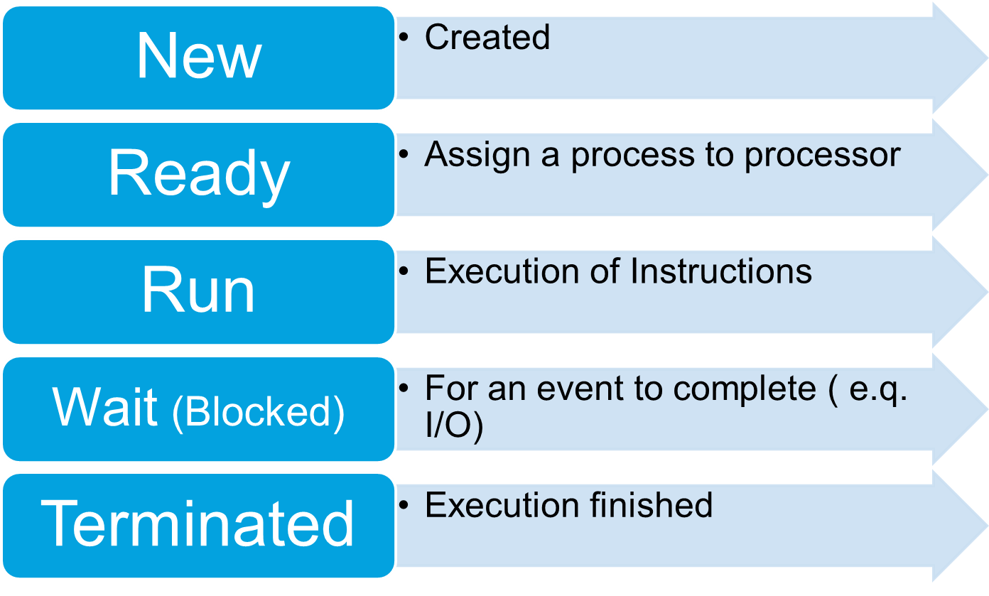
States of a Process
Notes:
New – The operating system recognizes the process but does not assign resources to it.
Ready – The process is ready/waiting to be assigned to a processor.
Run – When a process is selected by the CPU for execution, it moves to the run state.
Blocked – When a process is waiting for some event to occur, e.g. I/O completion then it moves to the blocked state. When a running process does not have immediate access to a resource, it is said to be in the blocked state.
Terminated – This is the final state reached when the process finishes execution.

Slide 27
Process State Diagram
Admitted
New
Interrupt
Ready
I/O or Event Completion
Processor Allocated
Run
Exit
I/O or Event wait (Blocked)
Wait
Terminated
For multiple processes, active process can be in ready or running state.
Ready state is the state when it is waiting for the CPU

Slide 28
Context Switching
Switching the CPU from one process to another process is called as Context Switch
Context Switching
  Keeps the CPU busy all the time
  Takes place when any of the following situations is encountered
    An I/O operation starts
    An interrupt occurs
    An I/O operation completes
    A process terminates
Notes:
Context switching is an overhead as the system does not do any useful work while switching from one process to another.
There can be more than one process waiting to be executed by the CPU, these processes must be put in hold at some place. A queue is a place where the IN and OUT of the processes is controlled. There are different queues for different purposes.
Example:
I/O Queue – If the process is waiting for an I/O operation to complete, then it goes to the I/O queue.
Job queue – A process entering the system for the first time goes into the Job queue.

Slide 29
Process Control Block
Structure in the Operating System which stores information about the status of the process
  Process id
  Process State
  Program Counter value for the process
  Register information
  Memory information for the process
  Accounting information
  List of open files
  Inter Process communication Information
  Pointer to the PCB of the next process to execute

Slide 30
Quiz
State True or False:
Context Switching is an overhead
A process cannot move from Run state to Ready state
Program is an active entity
Context Switching occurs when an I/O operation starts as well as completes
  Process requires processor, memory and ________ for its execution

Slide 31
File Management

Slide 32
File Concepts
File is a collection of data or information
File is a logical unit
  File Management System is a part of Operating System
  File System maps logical files to physical entities
  File System adds some attributes to the file in order to keep track of the file and manage it
Attributes of File
  Name
  Type – Ex.
  Protection
  Location
  Size
Notes:
Data is stored physically in storage media such as hard disks, magnetic tapes etc.
Operating system abstracts the data from the storage media and provides a uniform logical view of the information stored.
In order to keep track of the file and manage it, File System part of Operating system adds some attributes to the file.

Slide 33
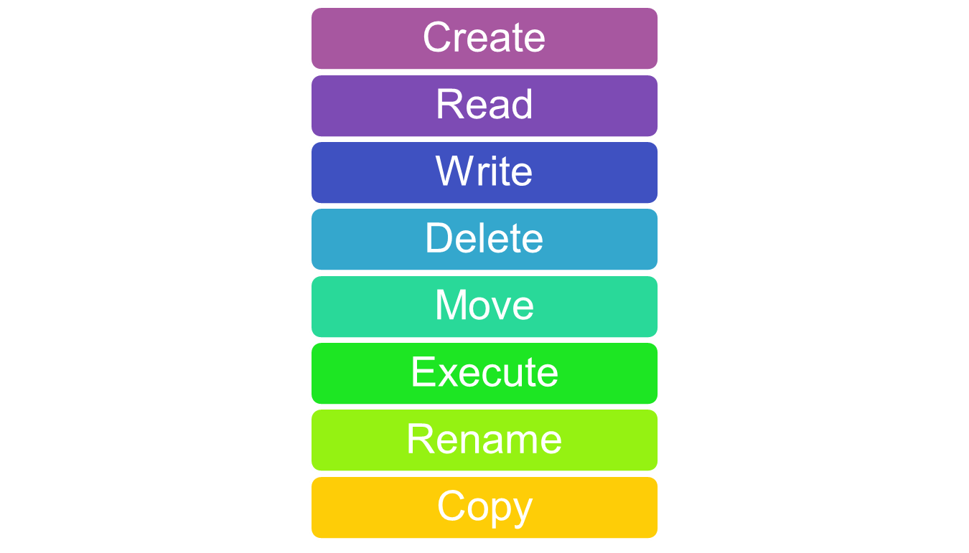
File Operations

Slide 34
File Management System
File System deals with effective information management
Features
  Minimal I/O operations on files
  Flexibility between logical and physical block size
  Automatic allocation of file space
  Flexible file naming facility such as links, aliases etc.

Slide 35
Responsibilities of File Management System
Keeping track of the location of the file like the track, the sector etc. to facilitate smooth accessing of the file
Allocation of storage space to the file if file is appended with more data
Relinquish the storage space on deletion of data from the file or file itself
Providing the ease of access to the files

Slide 36
File Systems
MSDOS -FAT file system
  File Allocation Table (FAT) is used to identify all the clusters of each and every file, allocated on the disk.
  Very trivial and was used in Microsoft’s DOS and early versions of Windows
UNIX - file system
  A data structure called i-node (Index Node) block is used for describing each and every file
  Very flexible and efficient
NTFS
  New Technology File System
  Microsoft propriety and used as replacement to FAT
  Very flexible and efficient

Slide 37
Comparison of Different File Systems
Features | FAT | NTFS | UNIX file System
Operating Systems | DOS and all versions of Windows | Windows NT, Windows 2000, Windows XP | UNIX and Unix based OS like Linux etc.
Volume size | Limited | Virtually unlimited | Virtually unlimited
Max file size | Limited | Limited by the volume of the disk | Limited by the volume of the disk
Number of files | Limited | Large | Large
Built-in security | No | Yes | Yes
Encryption | NO | Supported in the recent versions like NTFS 5. | Inherent
Fault tolerance | Low | High | High

Slide 38
Quiz
File is a ________ unit
_____________ adds some attributes to the file
_____________ is used for describing each and every file in UNIX
Encryption is supported in FAT (True/ False)
Fault Tolerance is low in NTFS (True/ False)

Slide 39
Device Management

Slide 40
Device Management
Device Management is a part of the operating system
Device Management manages to allocate a device to a user job on demand
Functions
  To provide the simplest interface possible to the system
  To optimize I/O operations
  To provide maximum concurrency
Notes:
A computer system has a big collection of I/O devices, e.g. printers, magnetic tapes, keyboard, monitor etc. Most of these devices are mechanical in nature, speed of operation of these devices is much slower as compared to the speed of the CPU and therefore results in a bottleneck and low CPU utilization. Due to this variation in the nature of devices, the OS has to provide device management.

Slide 41
Device Management (Allocation Policy)
Allocation Policy is of two types
  Dedicated
  Shared
Dedicated
  Some devices can be used in a serial and one-at-a-time manner. E.g. printer, tapes etc.
  It leads to monopoly
  Solution to monopoly is SPOOLing (Simultaneous Peripheral Operations Online)
  Jobs intended to be printed are saved on the disk until the job is completed. All the saved outputs will be eventually printed
Notes:
The main disadvantage of dedicated policy is that it leads to monopoly. If a user prints a large file, then others have to wait till the printing is over. A common solution to the above problem is SPOOLing wherein all the jobs needs to be printed are saved on the disk until the job is completed. The saved output will be printed finally. Thus, whenever simultaneous peripheral operations are made to the on-line resources, the requests are put in the queue and are stored in the spool files. When the resources are free, the spool file is retrieved and requests are serviced. The reason behind storing the file to be printed in a local disk is that even if the user closes the application that has given the output for printing, the printing is not interrupted. This happens because printing takes place from the local copy of the file available in the spool of the printer.

Slide 42
Device Management (Allocation Policy) (Contd.).
Shared
Devices are used concurrently by more than one job
Example
  Disk
Issues
  Readers and Writers problem
  Mutual Exclusion
  Security rights
Notes:
Readers and Writers problem – If there are two write requests for the same file in a disk, then the question is whether it should be allowed or not.
Mutual Exclusion – Although there are multiple jobs sharing access to the device, there can be only one job actually accessing at a point of time.
Security Rights - In case of shared devices, protection is needed against malicious or accidentally accessing one’s job area by another job

Slide 43
Quiz
Dedicated allocation policy leads to _________
___________ is a solution to the monopoly
Mutual Exclusion is an issue of ________ allocation policy
Device management ________ I/O operations
Printer can be used in ___________ manner

Slide 44
Summary
In this module, we discussed:
Operating System definition, its functions and different types of Operating System
Memory Management Unit and use of paging and segmentation in memory management
Process management and process lifecycle using state diagram
Various responsibilities of file management system and comparison of different file systems
Allocation policy in device management

Slide 45
References
Silberschatz, Abraham and Galvin, Peter B. Operating System Concepts. Ed 6. New Delhi: John Wiley, 2006.
Tanenbaum, Andrew S. Modern Operating Systems. Ed 3. New Delhi: Prentice Hall, 2007.
Milenkovic, Milan. Operating Systems: Concepts and Design. New Delhi: McGraw-Hill, 1992.
Crowley, Charles. Operating Systems: A Design-Oriented approach. Canada: Irwin Professional Publishing, 1996.
Hennessy, John L and Patterson, David A. Computer Architecture: A Quantitative Approach. Ed 2. Morgan-Kaufmann, 1996.

Slide 46
Thank You

